Slide 2
What is Phonics?
How we teach Phonics
Progression of Phonics
The Phonics Screening Check
What we are doing in school to support your child
How to support your child at home
Questions

Slide 3
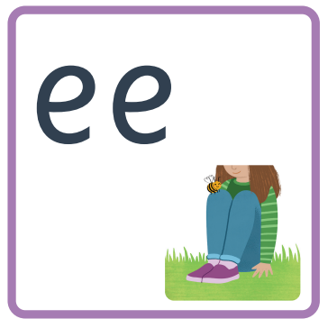
Notes:
Phonics is a method of teaching children how to read and write and to support their understanding of the alphabetic code or relationship between letters and sounds.
It supports children to hear, identify and use different sounds so they can distinguish one word from another in the English language.
Written language can be compared to a code, so knowing the sounds or phonemes that letters (graphemes) make will help children to decode words as they read.
Understanding phonemes also supports children in knowing which letters to use when they are writing words.

Slide 4
Notes:
Essential Letters and Sounds is our chosen phonics programme. It is a Dfe approved programme supported by the latest research evidence which identifies a systematic synthetic phonics programme as the best way for all children, regardless of their background, to learn to read early and acquire the skills they need to become fluent readers and writers.

Slide 5
Notes:
Children have lots opportunities throughout the day to develop and apply their knowledge and skills of the alphabetic code:
Formal phonics lessons
English lessons and foundation subjects
Morning lesson starters
Reading lessons and pleasure for reading sessions
Oral blending ‘Go and get your c-oa-t

Slide 6
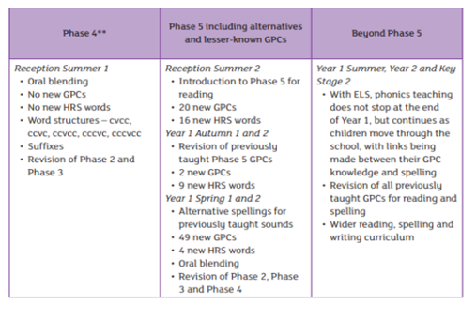
Notes:
It is systematic as the children are exposed to phonemes and graphemes in a carefully selected order.
In nursery, children are taught Phase 1 only – GPCS too to develop phonemic awareness and high quality adult interactions to develop auditory awareness readying them to use and apply in YR
Phase 2, 3, 4 and beginning of 5 in YR -a lot for children to learn in Year R so that they are ready for Y1 to become capable confident readers. Early building blocks are vital.
Phase 5 in Y1
Children are taught how to decode words through segmenting and blending.
Segmenting is breaking a word down into its individual sounds. For example, you can segment the word cat into its 3 sounds – c-a-t.
Blending is the process of combining sounds together to make words. c-a-t blends to make cat (model using robot arms).

Slide 7
Why Phonics is important
Reading and writing is fundamental in accessing all other areas of the curriculum
We want children to create a strong orthographic map to be able to be able to read fluently
Phonics helps the children to map sounds onto spelling, thus enabling them to decode words.
Decoding words aids the development of word recognition.
Improved word recognition increases reading fluency.
As they are no longer struggling with decoding words, they can concentrate on making meaning from the text.
Notes:
Phonics is just one element of reading. Comprehension is children’s understanding of what they are reading. This is why we ask children to read the same book multiple times, as they move from decoding words to reading words. From this they are then able to make meaning from the text.
We want children to create a strong orthographic map to be able to read fluently.
Orthographic mapping is the process by which children learn to connect sounds they already know to the spelling of words to make them instantly recognisable. To be able to do this, they need strong phonological and phonemic awareness
To consistently recognise that the ea in bread spells e, we need to read it many times, at least 4 times. So we need to read the word many times to build fluency for reading.

Slide 8
Phonics screening check
Statutory assessment conducted in every school in the summer term of Year 1
Introduced in 2011, to ensure that all children have learnt phonic decoding to an age-appropriate standard
40 words
Section 1 – 8 real words and 12 pseudo words
Section 2 – 12 real words and 8 pseudo words
Notes:
What is it?
The screening check is designed to show how well your child can use the phonic skills they have learned up to the end of Year 1
To identify which pupils need additional support as they progress on their reading journey
How does it work?
The check consists of 40 words and non-words (pseudo/alien) that your child will be asked to read, using the correct sounds and phonic rules to decode
Two sections of the check: one made up of simple word structures (CVC) and the other made up of more complex words structures
Administered by the teacher, same procedures as daily assessment
What do the scores mean?
Pass threshold of 32/40 since 2013: your child has met the required national standards
Below the standard, your child will be given additional support and repeat the screening check in Year 2

Slide 9
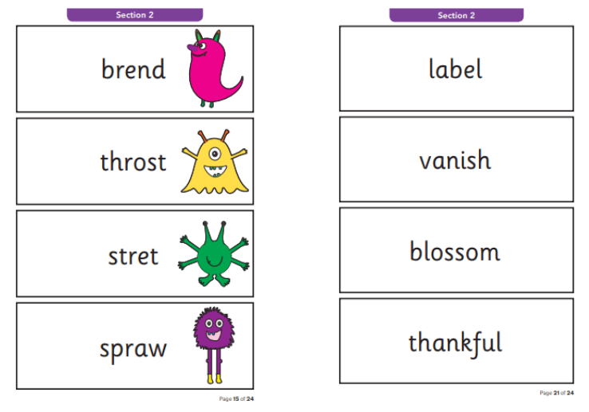
Phonics screening check
Notes:
The Phonics Screening Check
Each child will have as long as they need to complete the check – it generally takes around 10 minutes per child but this is not timed.
Informal, familiar, conducted by their teacher in same format as their individual reading session
Any accent or speech and language difficulty is taken into account when your child answers.
We take your child’s final answer – they are allowed to re-read words and correct themselves.

Slide 10
What we are doing in school
Daily teaching of phonics (30-40 minutes)
Frequent assessments of children’s current knowledge
Same day interventions within lessons
‘Booster’ phonics interventions for specific sounds
Decodable reading books
Individual reading sessions
Writing lessons – high quality texts
Reading for pleasure sessions
Notes:
Daily teaching of phonics through the Essential Letters and Sounds programme – 30-40 minutes day.
Frequent assessments so that teaching team has an accurate understanding of your child’s current phonic knowledge – week 5
Same day interventions – children who are finding the sound of the day challenging will take part in a same day intervention within the lesson to support them
Phonics booster interventions – use the assessment information to provide bespoke interventions to help fill gaps in knowledge
Reading books sent home should be fully decodable for the child, again based on our assessment information
Children will receive individual and guided reading sessions with a member of the team each week
Our writing lessons use high quality texts and provide opportunities for the children to apply their phonics skills and knowledge
We have daily ‘reading for pleasure’ sessions to promote a love of reading

Slide 11
How to help support your child
Read with your child a minimum of 4 times a week
Encourage your child to decode unfamiliar words
Pronounce pure sounds correctly
Make reading positive – praise and encouragement!
Model enjoying reading to your child
Flashcard practice – sounds and words
Spotting digraphs and trigraphs in words
Engage with any home learning set
Notes:
Read with your child daily if possible, if not a minimum of 4 times a week.
If your child is struggling with a word, encourage them to decode the word by segmenting it into its sounds and then blending these together. Avoid the child just guessing the word.
Pronunciation videos are on our website
Make reading positive – provide them with lots of encouragement and praise for having a go!
Model enjoying reading to your child – a love of reading can rub off on your child!
Flashcard practice – both sound cards and blending words.
Spotting digraphs and trigraphs in words (digraph is 2 letters making 1 sound and a trigraph is 3 letters making 1 sound).
Engage with any extra home learning set – this will be based on any gaps your child has.

Slide 12
Phonics Screening Check Support
For more information and ways to support at home, including past screening check examples, please see the links below:
https://www.theschoolrun.com/what-parents-need-know-about-year-1-phonics-screening-check
https://home.oxfordowl.co.uk/year-1-phonics-screening-check/
https://www.gov.uk/government/publications/phonics-screening-check-information-for-parents

