Slide 1
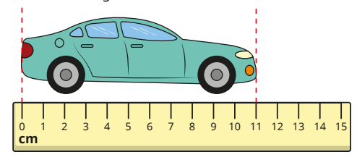
Year 1 Newsletter
Spring 2—2023/2024
Delete and insert academy logo
Notices and Reminders
Please can we remind our families that drinking bottles must only have water in them.
Below is a link to help with pronouncing all the different ELS phases sounds in phonics
https://essentiallettersandsounds.org/parents/
There are some fantastic free games on
Phonics Play that will help with blending to read https://www.phonicsplay.co.uk/resources
Key dates
February
Monday 19th - Back to school
Wednesday 21st - Dog Safety Assembly (in school event)
Wednesday 28th - SEN Come and Ask Drop-in Session with Mrs Mott
(10am-12pm)
March
Friday 1st - St David's Day, children can come into school where club uniform
Thursday 7th - World Book Day, children can come to school wearing cosy PJ's
Friday 15th - Red Nose Day, wear something Red
Monday 25th - Year 2 Visit to C of E (1.30-2.30pm)
Wednesday 27th - End of term
1.15pm finish
Phonics
The children are learning alternative spellings for previously taught sounds:
/u/ o (brother) /j/ g (gem), /j/ ge (fringe)
/j/ dge (bridge) /s/st (listen) /s/ce (fence)
/s/ se (house) /n/ gn (sign) /n/ kn (knee)
/r/ wr (wrap) /m/ <mb> (lamb) /z/ se (cheese)
/z/ se (freeze) /ear/ eer (cheer) /ear/ ere here)
/sh/ ti (patient /sh/ tion (station)
/ar/ al (half) /or/ augh (caught) /sh/ ss (session)
/zh/ si (vision) /sh/ tious (scrumptious)
/sh/ ci (delicious) ous, -ion, -ian
Writing
This half term the children will be using the Talk for Writing approach to learn some new texts.
The new texts will be: 'The Night Pirates' and 'A Sorry Letter From The Night Pirates' and 'A Squash and a Squeeze'.
Maths
This half term in maths, the children will be building on their place value knowledge by looking at numbers within 50. The children will develop their understanding of partitioning, looking how many tens and ones a number is made from. The children will spend time looking at measure, focusing on height and length. Finally, the children will develop our understanding on mass, volume and capacity.

Slide 2
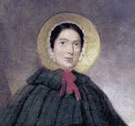
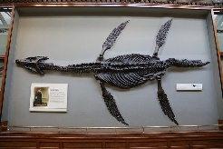
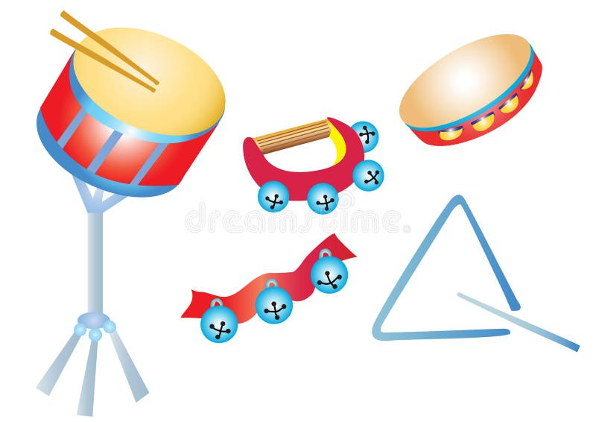
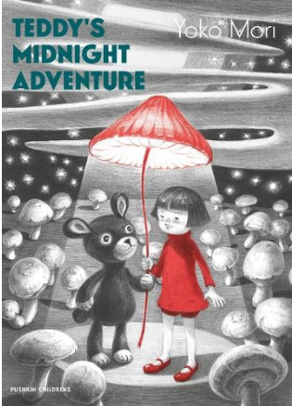
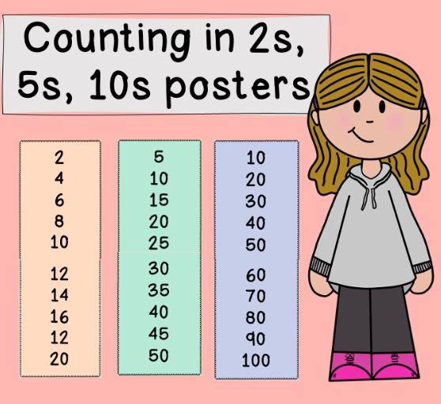
Science
We are continuing to answer the question, how many of each type of animal are there, by identifying and classifying. We will be learning about carnivore, herbivore and omnivores and how to sort animals into these groups. Then we move onto the question of how does littering effect animals. The children will research pollution and the impact of littering on our environment. Then finishing the topic learning about the process and benefits of recycling.
History
In our history lessons the children will look the big question - How did Mary Anning help change society? The children will learn about her life and learn about how her remarkable discoveries revealed a prehistoric world filled with strange creatures.
RE
Using books, artefacts, artwork, drama and exploration outside, we will explore the question: How did the world come to be? We will focus on Christianity and Judaism to consider: What does creation mean? What is the Christian and Jewish creation story? Who are Adam and Eve? What creation story do I believe?
PE
In PE the children will be learning about athletics. They will be learning to run at different speeds, pass a baton in a relay race, jump, hop and balance. The children will also learn how to throw and receive objects for example quoits, beanbags and hoops.
Music
The children will be using the Charanga music scheme to listen to music, sing songs and move to the beat. They will be exploring different types of music and its origins as well as learning new musical vocabulary. The children will be having lots of fun and performing in groups to the rest of the class!
PSHE
This half term the children will be learning about money. They will first explore the difference between a 'want' and a 'need' before learning about what money is. This will include learning about how money can be gained, and the jobs children might like to do in the future. Finally, the children will discuss the different things they can do with money.
Homework
Daily read or as often as possible please
Counting in 2s, 5s and 10s
Suggested books for reading
The Search for Giant Arctic Jellyfish by Chloe Savage
Teddy's Midnight Adventure by Yoko Mori

