Slide 1
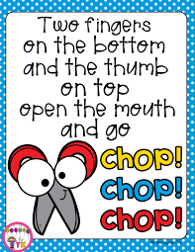
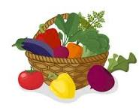
EYFS Newsletter
Spring 2—2023/2024
Delete and insert academy logo
Key dates
Please bring a named water bottle, coat and bookbag to school every day.
PE and library are on Wednesday, please remove any earrings.
A gentle reminder that there should be no other jewelry or nail varnish worn to school.
PE kit and uniform needs to be clearly named.
Key dates
February
Monday 19th - Back to school
Wednesday 21st - Dog Safety Assembly (in school event)
Wednesday 28th - SEN Come and Ask Drop-in Session with Mrs Mott
(10am-12pm)
March
Friday 1st - St David's Day, children can come into school where club uniform
Thursday 7th - World Book Day, children can come to school wearing cosy PJ's
Friday 15th - Red Nose Day, wear something Red
Wednesday 27th - End of term
1.15pm finish
Communication and Language
The children will listen to a range of stories and share non-fiction texts through our Talk for Writing and topic learning. They will focus on retelling a story. To develop their confidence to speak to a larger group, the children will be given more opportunities to share their work with their class and talk about it.
The children will develop vocabulary in a range of contexts, encouraging the children to use different, perhaps more adventurous words and to understand the meaning of others.
Physical Development
This half term the children will be focusing on forming capital letters. The children will also be focusing on their scissor skills cutting circles, squares and irregular shapes.
In PE, the children will be developing ball skills. They will be refining their skills on throwing and catching with a partner, throwing one handed and kicking. The children will be applying these skills in some simple ball games.
Personal, Social and Emotional Development
This half term our theme is 'Healthy Me'. The children will be learning the importance of a healthy lifestyle.
They will be learning about healthy food choices, exercise, sleep and the importance of keeping clean.

Slide 2
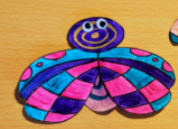
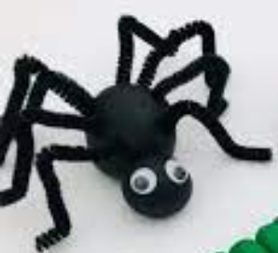
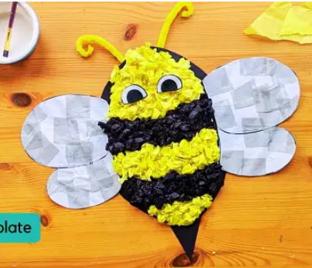
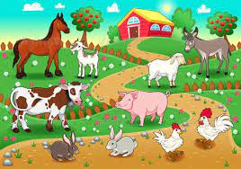
Literacy
In phonics, the children will be revising all of the sounds taught so far and will have lots of opportunities to apply them in different contexts.
In Talk for Writing, the children will be learning 'We're Going on a Bear Hunt', '10 Little Caterpillars' and the non-fiction text 'Chickens'. They will be learning about what a setting is and what verbs are and using these to structure their own writing.
Mathematics
In Maths, the children will consolidate their understanding of height and work on the concept of time, learning to order and sequence events.
They will then move onto ‘Building 9 and 10’, exploring the composition of these numbers and will become familiar with number bonds to ten. The children will also explore doubling facts and recap odds and evens.
The children will then move onto naming and recognising 3D shapes and will explore how to find 2D shapes within them.
Understanding the World
As part of our topic, the children are learning about different types of animals and their young. The children will compare pets, farm animals and wild animals on land and in the sea. Linked to our story, 10 Little Caterpillars, the children will be learning about mini beasts. The term will then end with learning about the signs of Spring, including life cycles and Easter.
In RE the children will be learning about Christianity. This will include thinking about the special place and book for Christians and learning the Easter story .
Expressive Arts and Design
In music, the children will continue to explore percussion instruments, using these to investigate the beat of different genres of music.
The children will be exploring different tools and techniques to make artwork using the skills they have learnt such as join and modelling techniques.
Homework
Daily read or as often as possible.
Use the letter formation sheets to practice handwriting.
Practice reading harder to read words on sight and when you know them have a go at spelling them.
Please continue to check Tapestry for other homework ideas or to find out what we are talking about in class from week to week.
We love seeing all the Tapestry posts from home and celebrating the children's achievements.
Suggested books for reading
We're Going on a Bear Hunt by Michael Rosen
Ten Little Caterpillars by Bill Martin Jr.
Chickens by Kate Riggs
Farmer Duck by Martin Waddell
Super Worm by Julia Donaldson
This is How We Do It by Matt Lamothe

